Slide 1
Future of Computing: Moore’s Law & Its Implications + High-Performance Computing 15-213: Introduction to Computer Systems 27th Lecture, Nov. 29, 2018

Slide 2
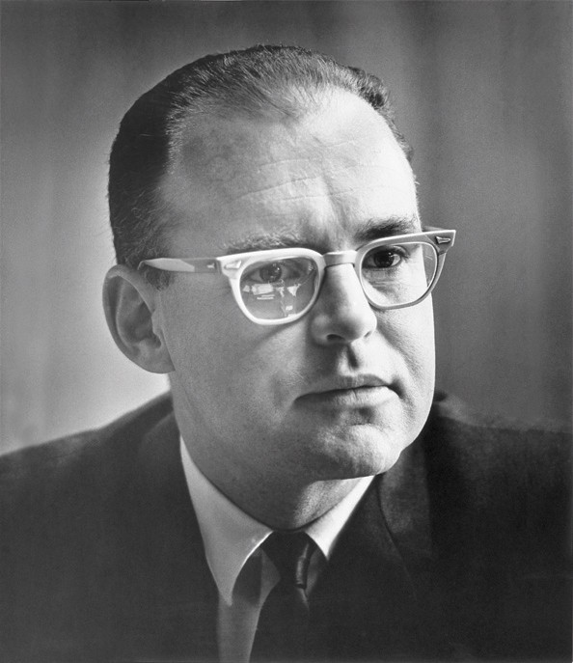
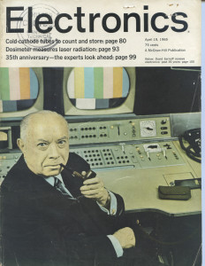
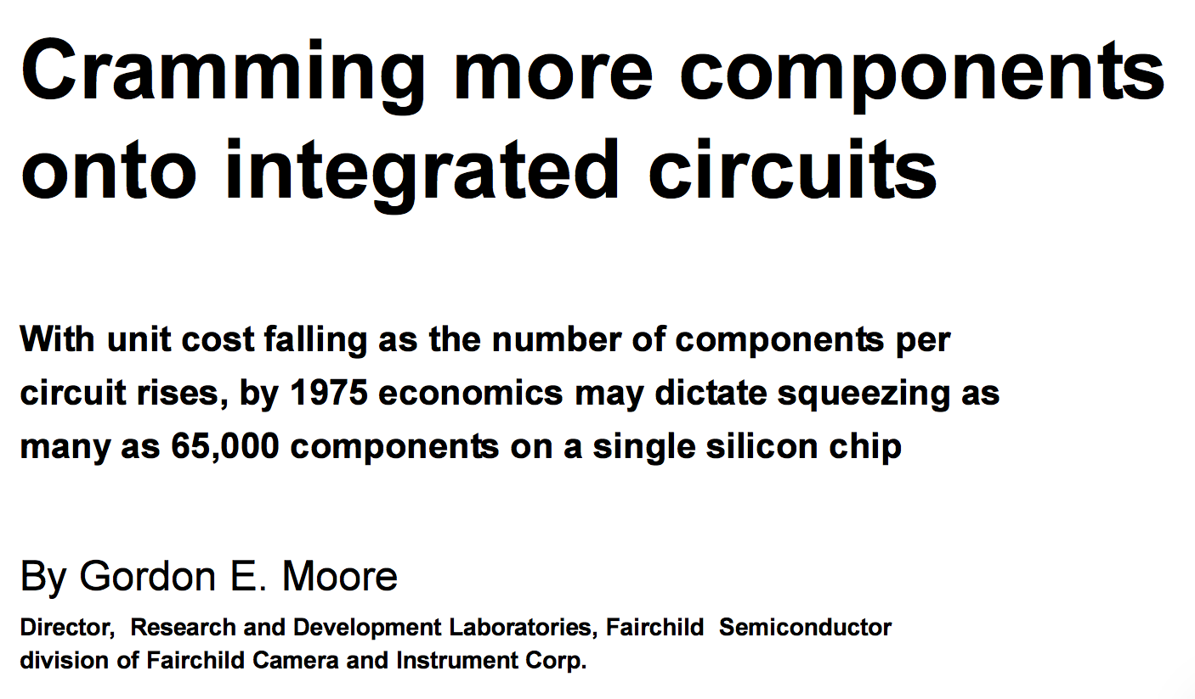
Moore’s Law Origins
April 19, 1965

Slide 3
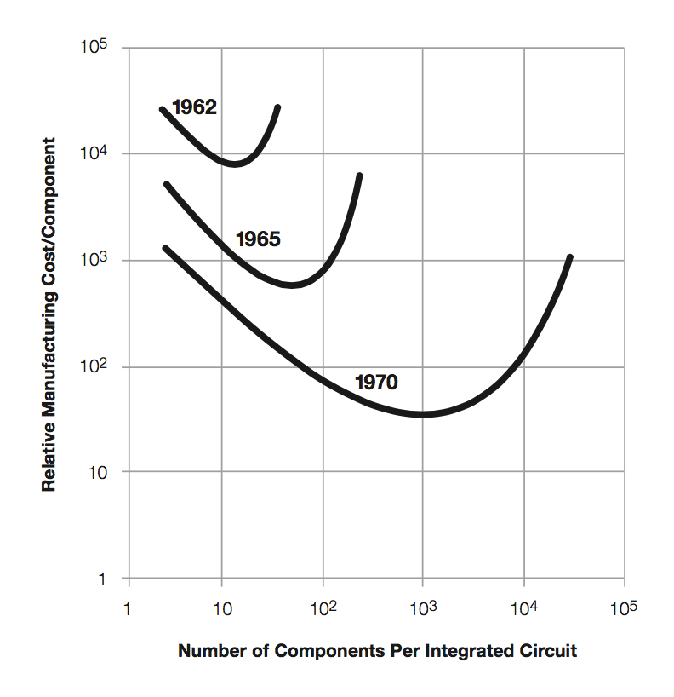
Moore’s Law Origins
Moore’s Thesis
Minimize price per device
Optimum number of devices / chip increasing 2x / year
Later
2x / 2 years
“Moore’s Prediction”
1965: 50
1970: 1000

Slide 4
Moore’s Law: 50+ Years
Sample of
130 processor chips
Wikipedia:
Transistor_count

Slide 5
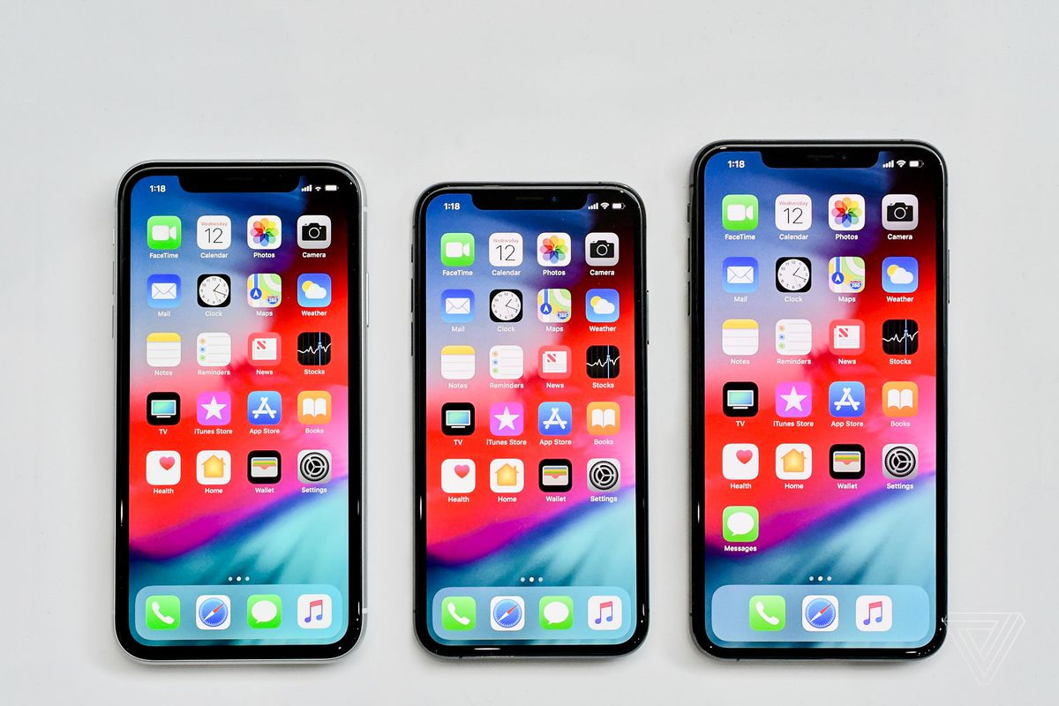
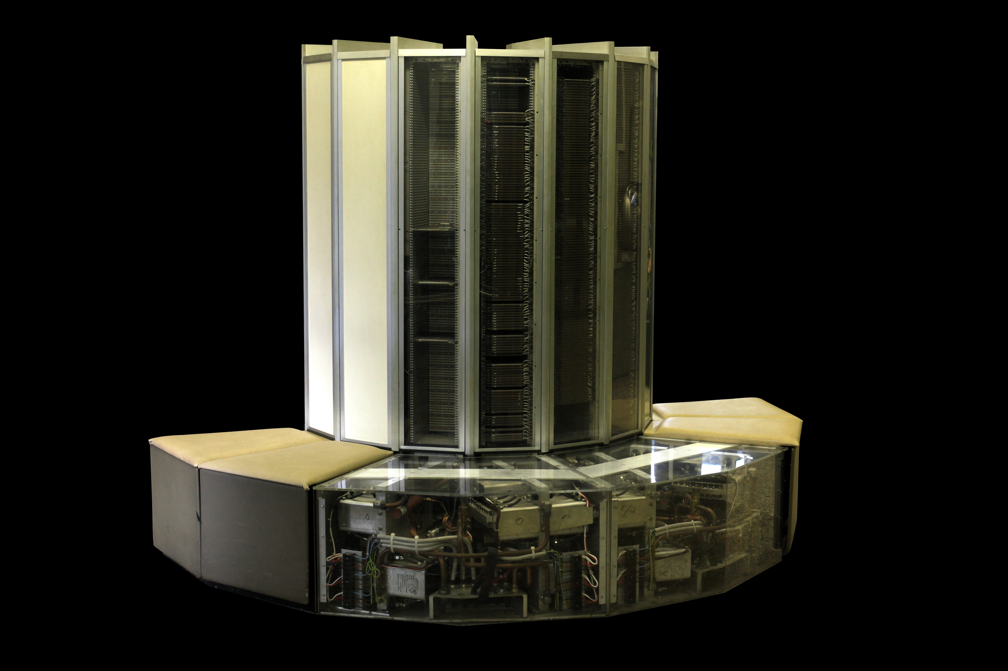
Moore’s Law Benefits
1976 Cray 1
250 M Ops/second
~170,000 chips
0.5B transistors
5,000 kg, 115 KW
$9M
80 manufactured
2018 iPhone XS
> 10 B Ops/second
8 chips
6.9 B transistors (CPU only)
177 g, < 5 W
$999
~9 million sold in first 7 days

Slide 6
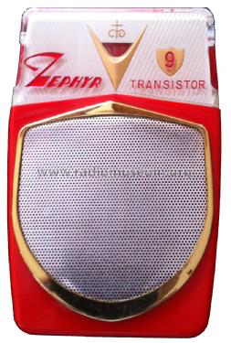
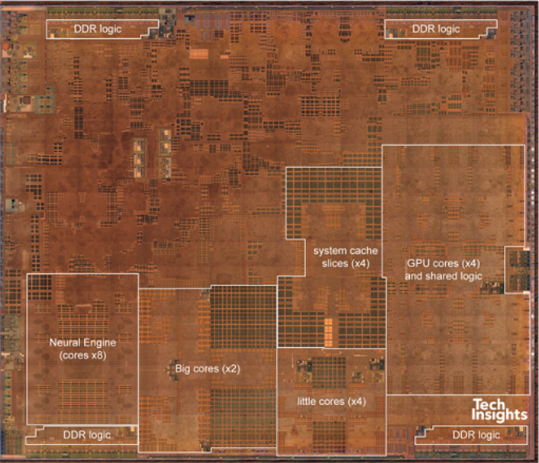
What Moore’s Law Has Meant
1965 Consumer Product
2018 Consumer Product
Apple A12
6.9 B transistors
(not to scale)

Slide 7
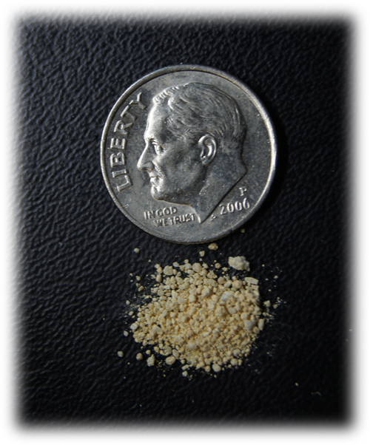
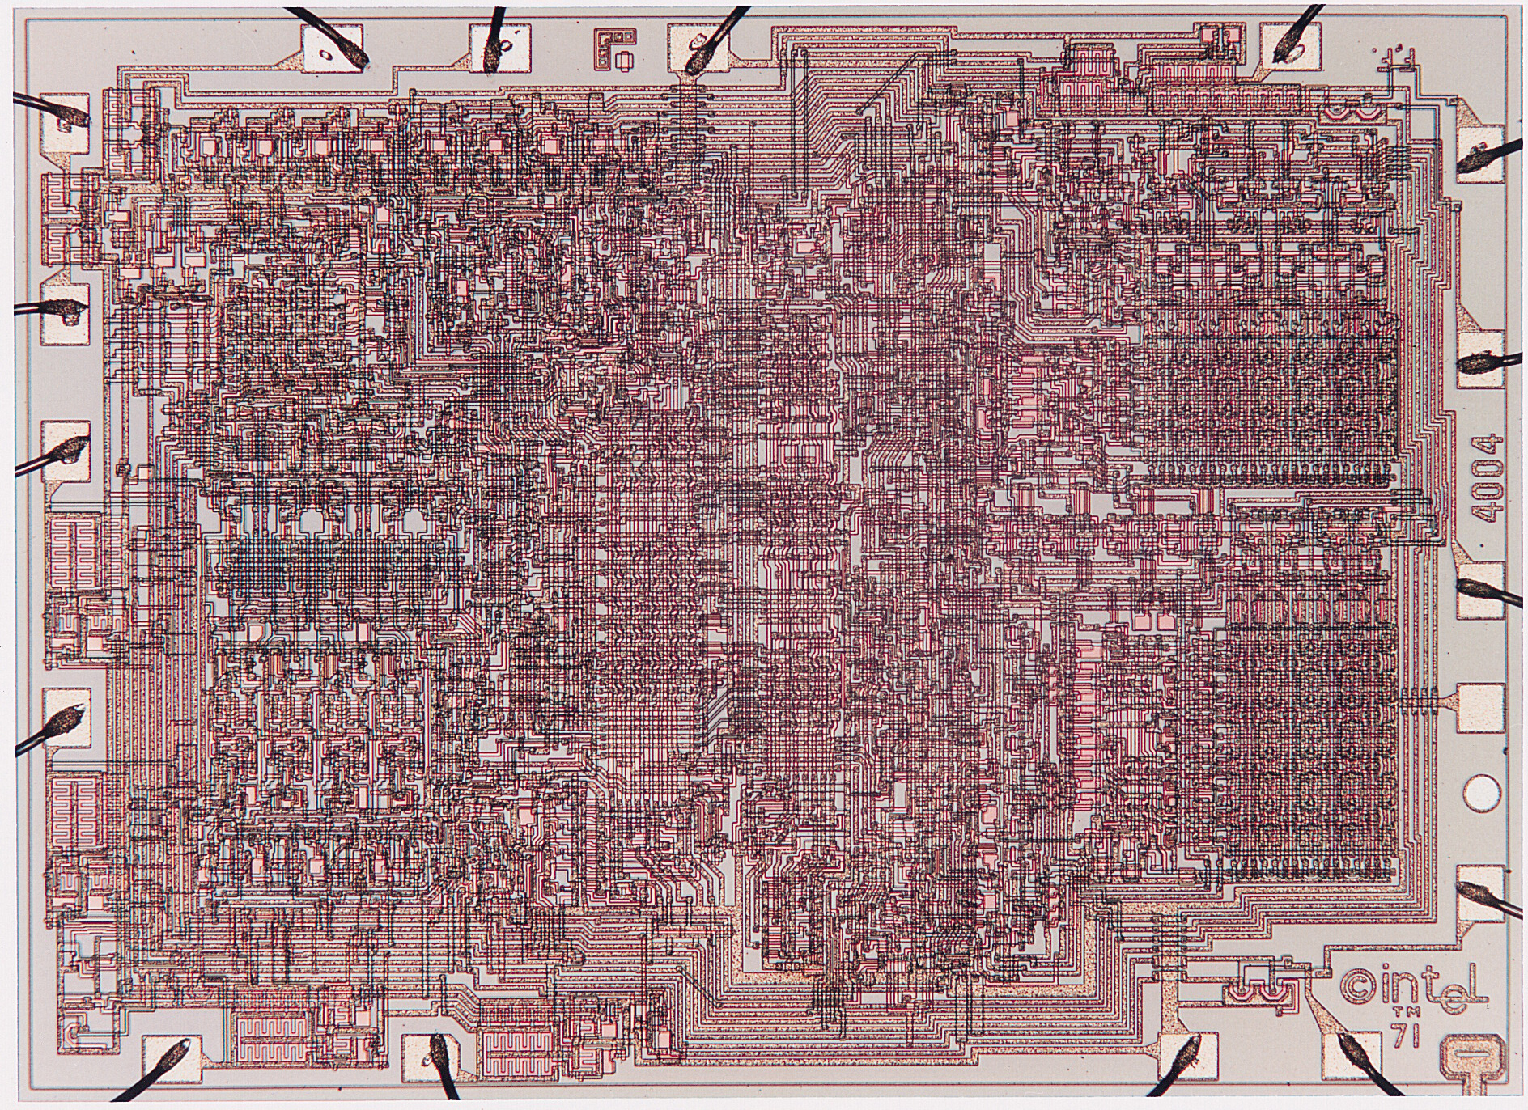
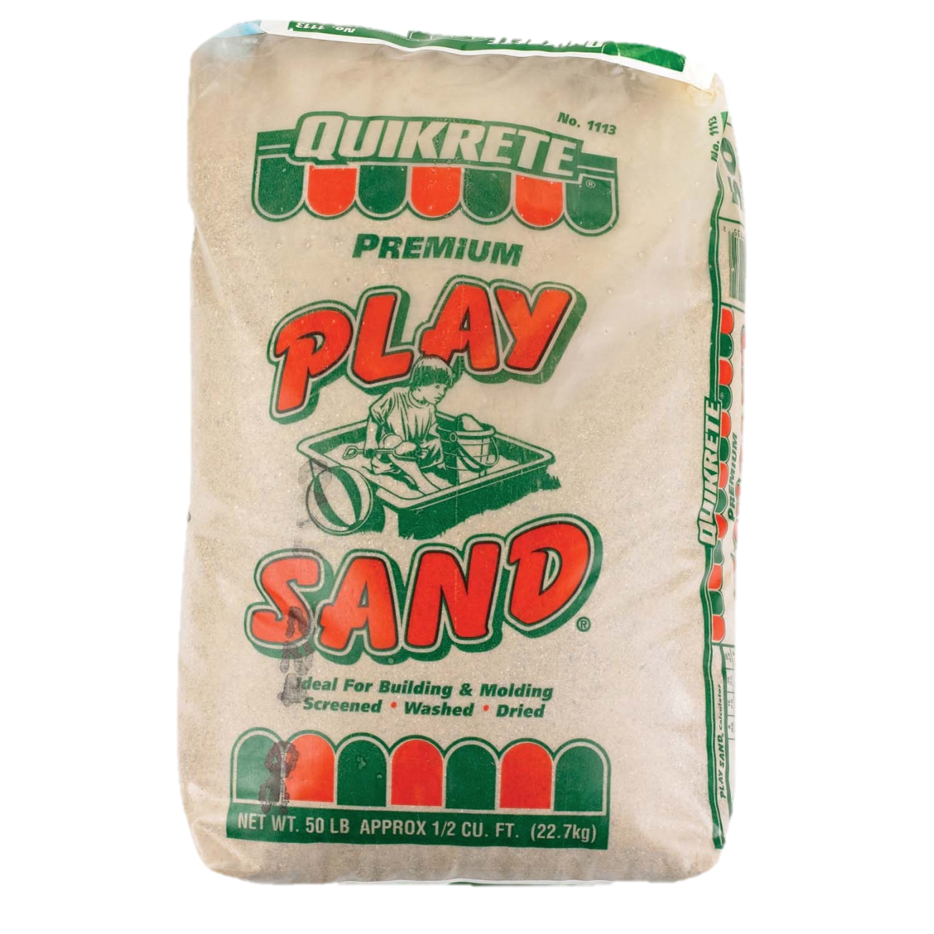
Visualizing Moore’s Law to Date
If transistors were the size of a grain of sand
Intel 4004
1970
2,300 transistors
0.1 g
Apple A12
2018
6.9 B transistors
300 kg

Slide 8
What Does 6.9 Billion Transistors Provide?
4 CPUs
2 high performance
4 low power
4 GPUs
Graphics/image/video processing
Neural Engine
For AI applications
Lots of specialized logic
Video encode / decode
Image stitching

Slide 9
Moore’s Law Economics
Better
Products
Sales $$
Capital +
R&D Investment
Product
Design
New Technology
Consumer products sustain the
$300B semiconductor industry

Slide 10
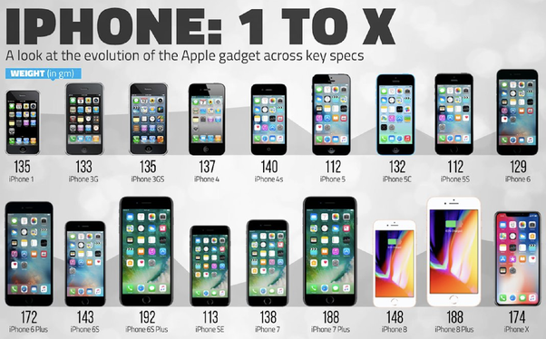
What Moore’s Law Has Meant
20 versions of iPhone since 2007

Slide 11
What Moore’s Law Could Mean
2018 Consumer Product
2065 Consumer Product
Portable
Low power
Will drive markets & innovation
?

Slide 12
Requirements for Future Technology
Must be suitable for portable, low-power operation
Consumer products
Internet of Things components
Not cryogenic, not quantum
Must be inexpensive to manufacture
Comparable to current semiconductor technology
O(1) cost to make chip with O(N) devices
Need not be based on transistors
Memristors, carbon nanotubes, DNA transcription, ...
Possibly new models of computation
But, still want lots of devices in an integrated system

Slide 13
Moore’s Law: 100 Years
10¹⁷ devices!

Slide 14
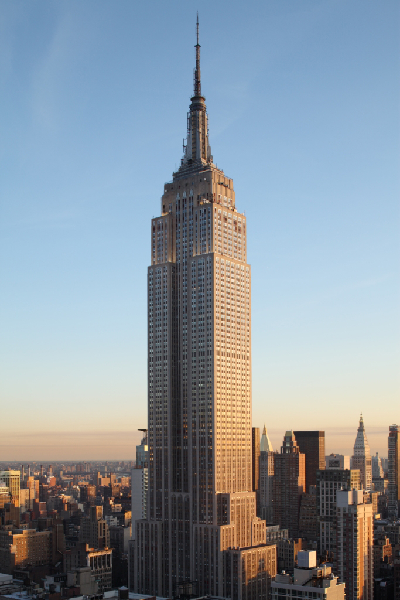
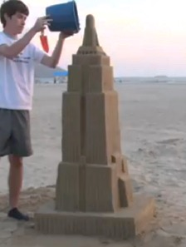
Visualizing 10¹⁷ Devices
If devices were the size of a grain of sand
0.1 m³
3.5 X 10⁹ grains
1 million m³
0.35 X 10¹⁷ grains

Slide 15
Increasing Transistor Counts
Chips have gotten bigger
1 area doubling / 10 years
Transistors have gotten smaller
4 density doublings / 10 years
Will these trends continue?

Slide 16
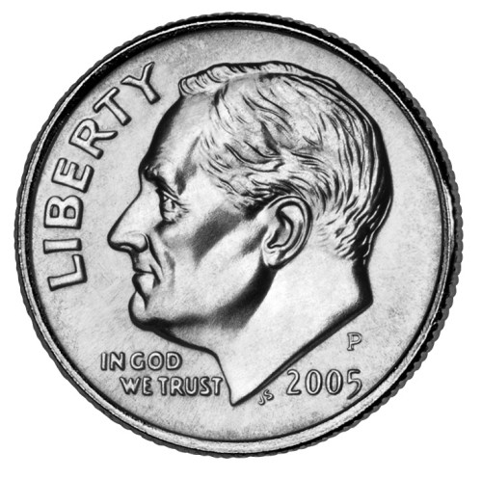
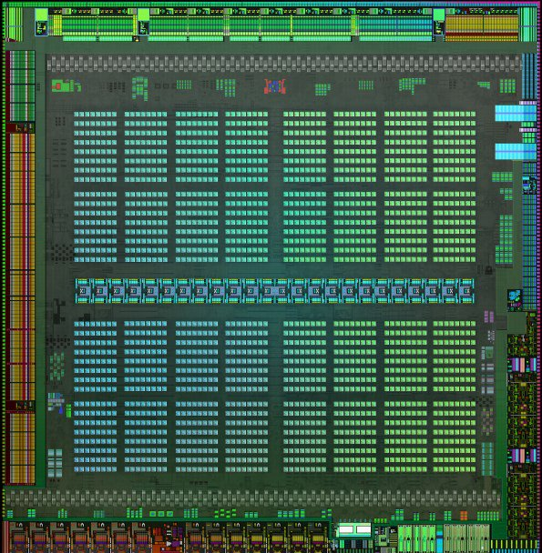
Chips Have Gotten Bigger
NVIDIA GV100 Volta
2017
21.1 B transistors
815 mm²
Intel 4004
1970
2,300 transistors
12 mm²
Apple A12
6.9 B transistors
83 mm²

Slide 17
Chip Size Trend
2x every 9.8 years

Slide 18
Chip Size Extrapolation
147 cm²

Slide 19
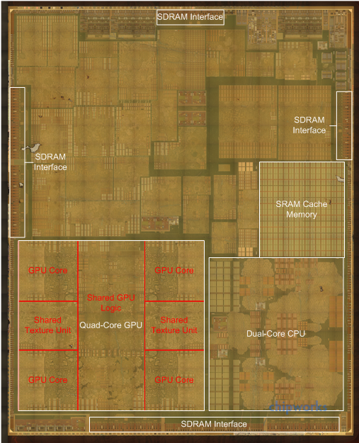
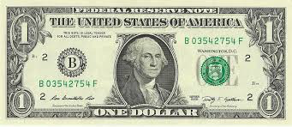
Extrapolation: The iPhone XXX
Apple A111
2065
10¹⁷ transistors
147 cm²

Slide 20
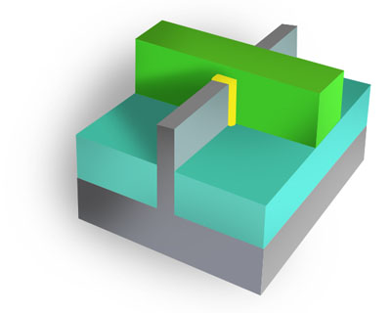
Transistors Have Gotten Smaller
Area A
N devices
Linear Scale L
L

Slide 21
Linear Scaling Trend
1/2x every 5 years ➔
2x transistor density every 2.5 years

Slide 22
Decreasing Feature Sizes
Apple A12
2018
6.9 B transistors
L = 110 nm
Intel 4004
1970
2,300 transistors
L = 72,000 nm

Slide 23
Linear Scaling Trend
Submillimeter
Submicrometer

Slide 24
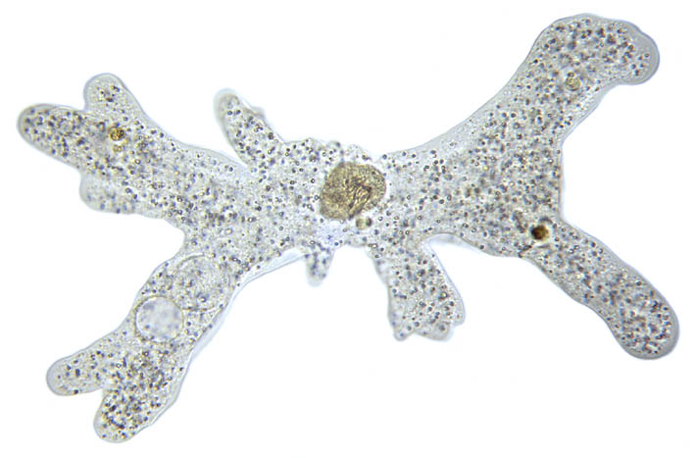

Submillimeter Dimensions
10⁻³
1 millimeter (mm)
500μm: Length of amoeba
10⁻⁴
72μm: Intel 4004 linear scale
50μm: Average size of cell in human body
10⁻⁵
10μm: Thickness of sheet of plastic food wrap
5μm: Spider silk thickness
2μm: E coli bacterium length
10⁻⁶
1 micrometer (μm)

Slide 25

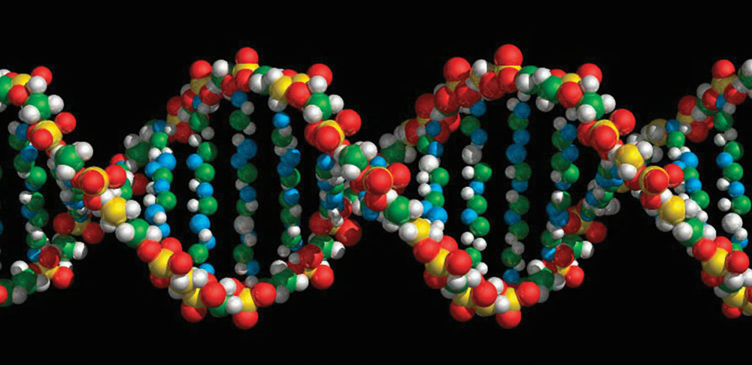
Submicrometer Dimensions
10⁻⁶
1 micrometer (μm)
400-700nm: Visible light wavelengths
10⁻⁷
110nm: Apple A12 linear scale
30nm: Minimum cooking oil smoke particle diameter
10⁻⁸
9nm: Cell membrane thickness
2nm: DNA helix diameter
10⁻⁹
1 nanometer (nm)
1nm: Carbon nanotube diameter

Slide 26
Linear Scaling Extrapolation
243 pm

Slide 27
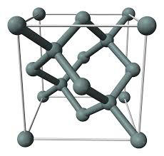
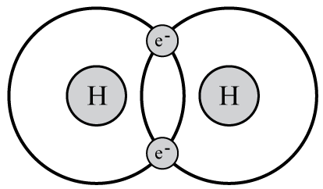
Subnanometer Dimensions
1 nanometer (nm)
10⁻⁹
1nm: Carbon nanotube diameter
543pm: Silicon crystal lattice spacing
243pm: 2065 linear scale projection
10⁻¹⁰
74pm: Spacing between atoms in hydrogen molecule
53pm: Electron-proton spacing in hydrogen (Bohr radius)
10⁻¹¹
2.4pm: Electron wavelength (Compton wavelength)
1 picometer (pm)
10⁻¹²

Slide 28
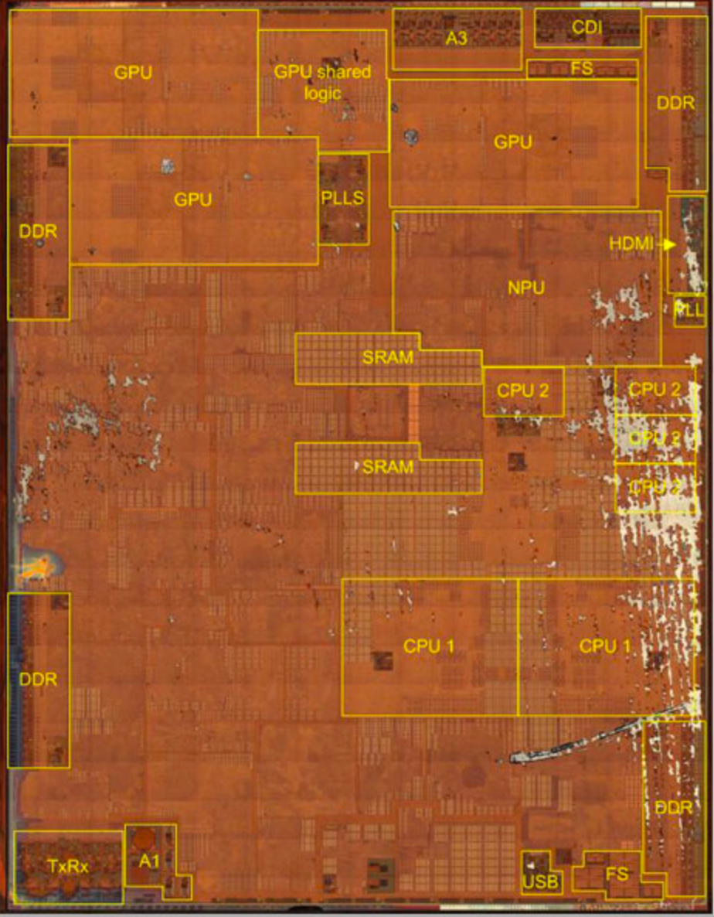
Reaching 2065 Goal
Target
10¹⁷ devices
400 mm²
L = 63 pm
Is this possible?
No!
Not with 2-d
fabrication

Slide 29
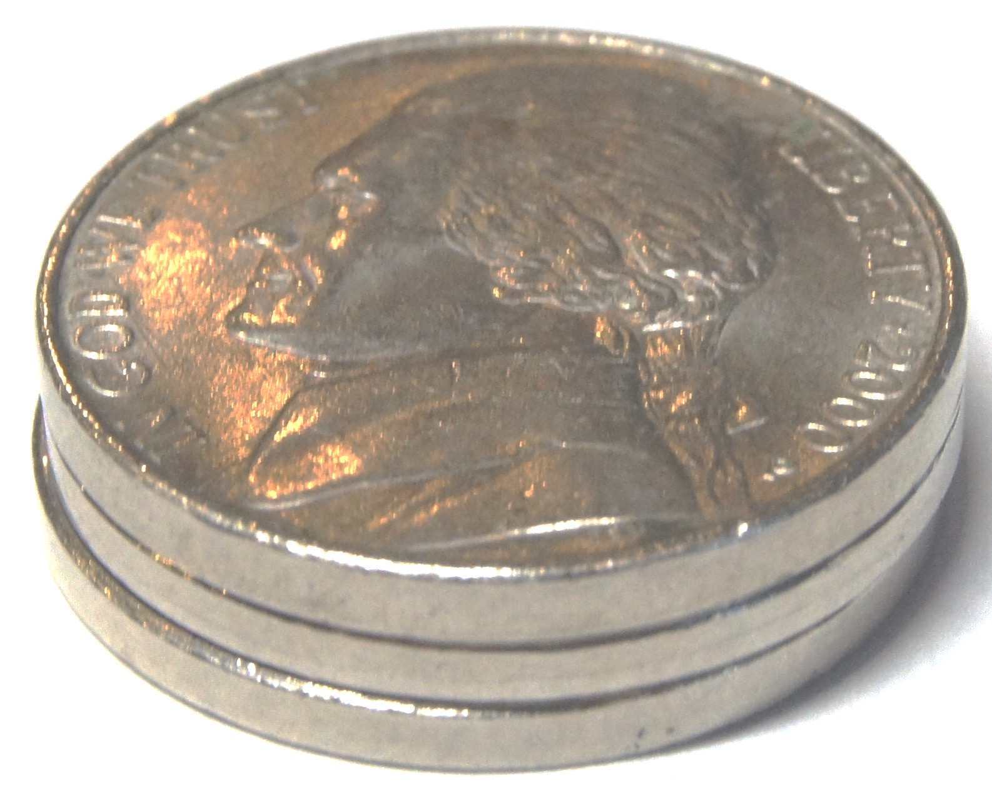
Fabricating in 3 Dimensions
2000 mm³
5 mm
20 mm
20 mm
Parameters
10¹⁷ devices
100,000 logical layers
Each 50 nm thick
~1,000,000 physical layers
To provide wiring and isolation
L = 20 nm
10x smaller than today
2065 mm³

Slide 30
3D Fabrication Challenges
Yield
How to avoid or tolerate flaws
Cost
High cost of lithography
Power
Keep power consumption within acceptable limits
Limited energy available
Limited ability to dissipate heat

Slide 31
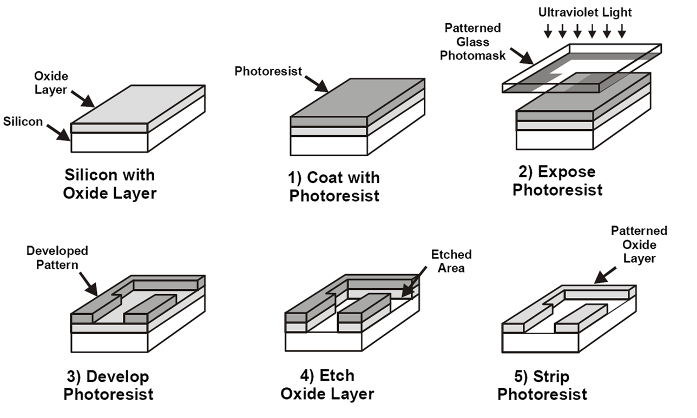
Photolithography
Pattern entire chip in one step
Modern chips require ~60 lithography steps
Fabricate N transistor system with O(1) steps

Slide 32
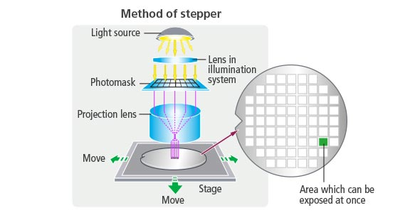
Fabrication Costs
Stepper
Most expensive equipment in fabrication facility
Rate limiting process step
18s / wafer
Expose 858 mm² per step
1.2% of chip area

Slide 33
Fabrication Economics
Currently
Fixed number of lithography steps
Manufacturing cost $10–$20 / chip
Including amortization of facility
Fabricating 1,000,000 physical layers
Cannot do lithography on every step
Options
Chemical self assembly
Devices generate themselves via chemical processes
Pattern multiple layers at once

Slide 34
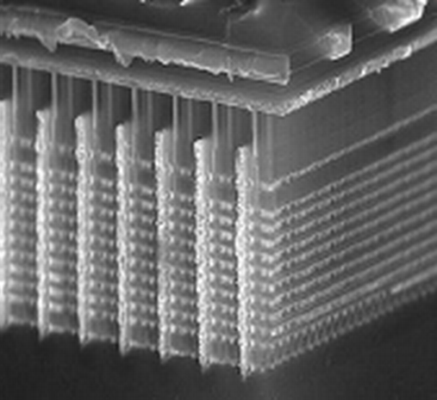
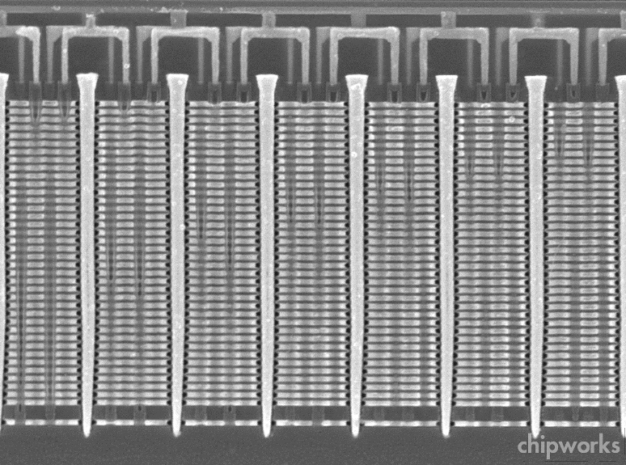
Samsung V-Nand Flash Example
Build up layers of unpatterned material
Then use lithography to slice, drill, etch, and deposit material across all layers
~30 total masking steps
64 layers of memory cells (soon to be 96)
Exploits particular structure of flash memory circuits

Slide 35
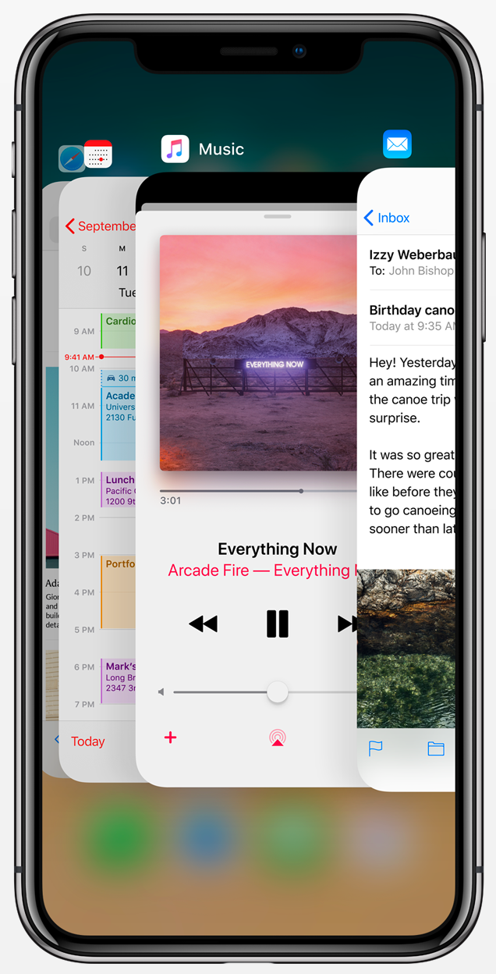
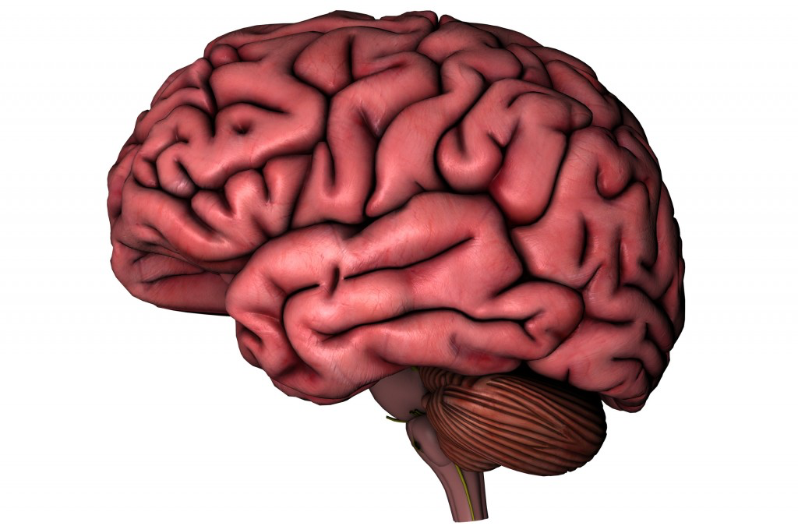
Meeting Power Constraints
6.9 B transistors
2.5 GHz operation
1—5 W
64 B neurons
100 Hz operation
15—25 W
Liquid cooling
Up to 25% body’s total energy consumption
Can we increase number of devices by 10,000,000x without increasing power requirement?

Slide 36
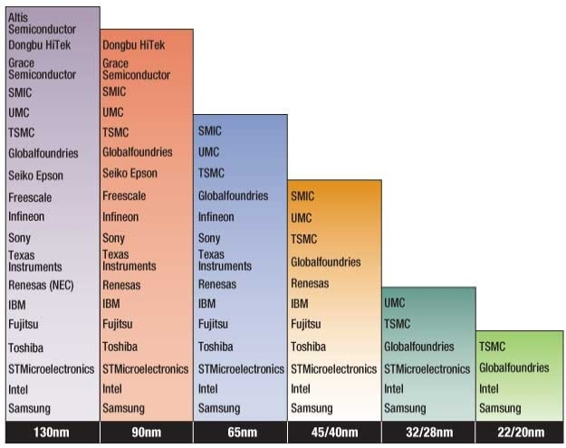
Challenges to Moore’s Law: Economic
Growing Capital Costs
State of art fab line ~$20B
Must have very high volumes to amortize investment
Has led to major consolidations
2018: Global Foundaries won’t attempt 7nm fabrication

Slide 37
Dennard Scaling
Due to Robert Dennard, IBM, 1974
Quantifies benefits of Moore’s Law
How to shrink an IC Process
Reduce horizontal and vertical dimensions by k
Reduce voltage by k
Outcomes
Devices / chip increase by k²
Clock frequency increases by k
Power / chip constant
Significance
Increased capacity and performance
No increase in power

Slide 38
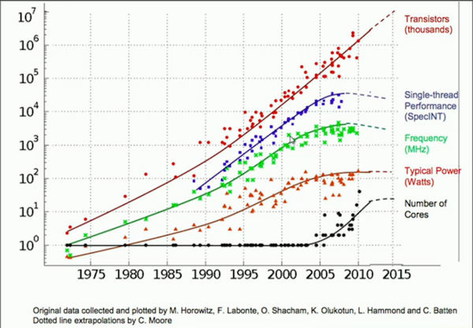
End of Dennard Scaling
What Happened?
Can’t drop voltage below ~1V
Reached limit of power / chip in 2004
More logic on chip (Moore’s Law), but can’t make them run faster
Response has been to increase cores / chip

Slide 39
Some Thoughts about Technology
Compared to future, past 50 years will seem fairly straightforward
50 years of using photolithography to pattern transistors on two-dimensional surface
Questions about future integrated systems
Can we build them?
What will be the technology?
Are they commercially viable?
Can we keep power consumption low?
What will we do with them?
How will we program / customize them?

Slide 40
High-Performance Computing

Slide 41
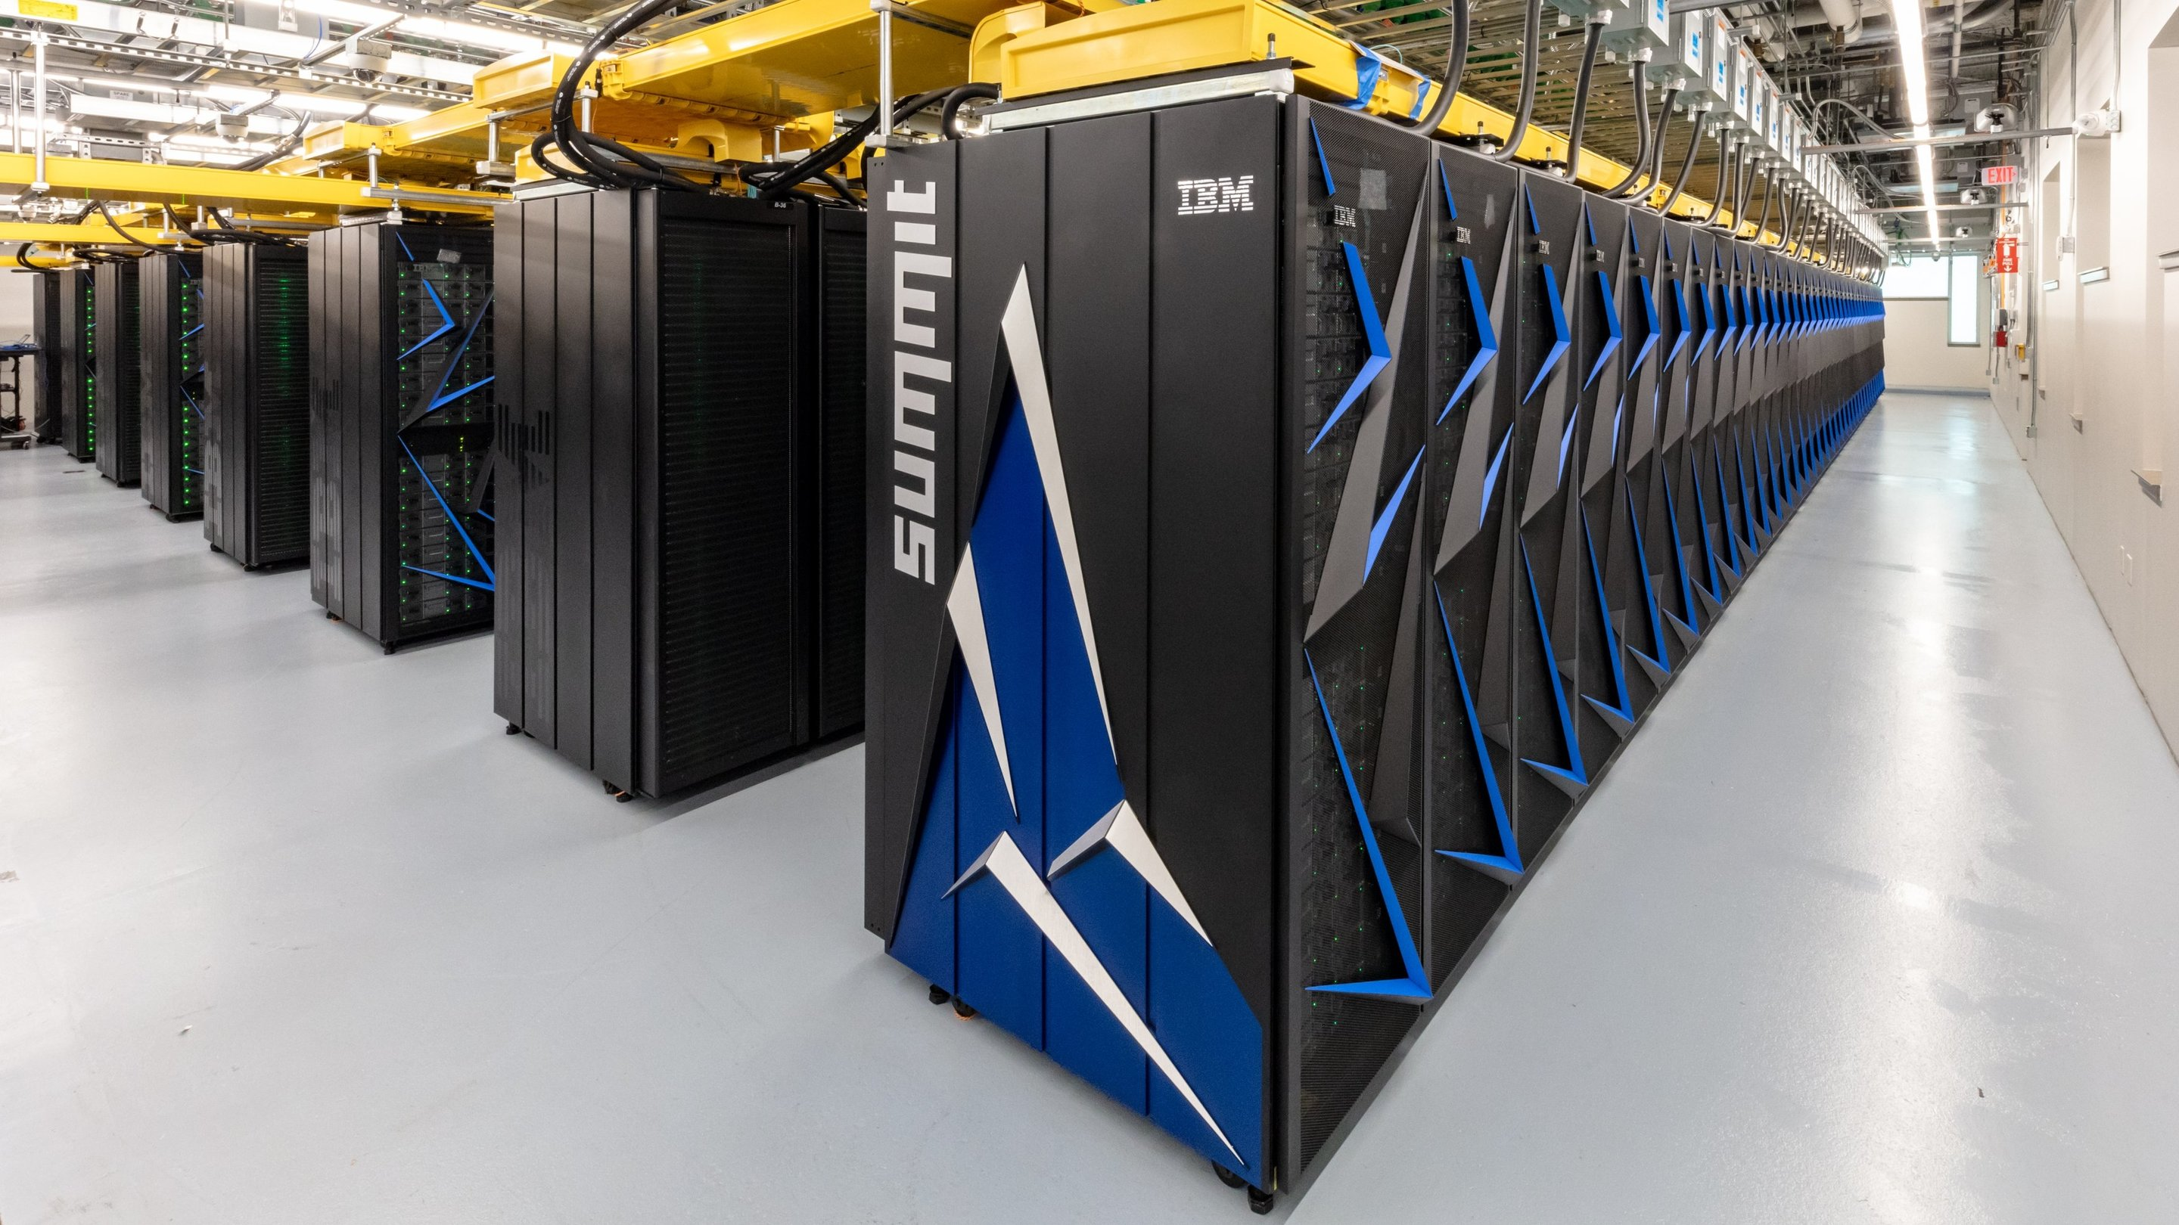
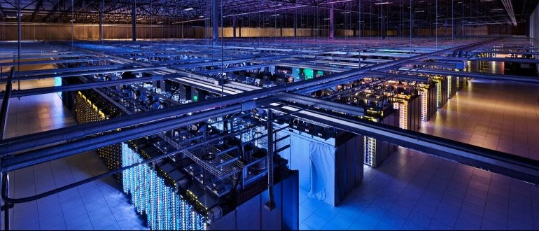
Comparing Two Large-Scale Systems
Oakridge Summit
Monolithic supercomputer (fastest in world)
Designed for compute-intensive applications
Google Data Center
Servers to support millions of customers
Designed for data collection, storage, and analysis

Slide 42
Computing Landscape
Google Data Center
Data Intensity
Web search
Mapping / directions
Language translation
Video streaming
Internet-Scale
Computing
Oakridge
Summit
Cloud
Services
Traditional Supercomputing
Modeling &
Simulation-Driven
Science &
Engineering
Personal
Computing
Computational Intensity

Slide 43
Supercomputing Landscape
Data Intensity
Oakridge
Summit
Traditional Supercomputing
Modeling &
Simulation-Driven
Science &
Engineering
Personal
Computing
Computational Intensity

Slide 44
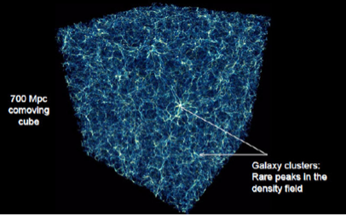
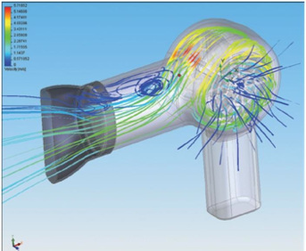
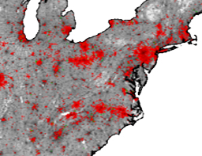
Traditional Supercomputer Applications
Science
Industrial Products
Public Health
Simulation-Based Modeling
System structure + initial conditions + transition behavior
Discretize time and space
Run simulation to see what happens
Requirements
Model accurately reflects actual system
Simulation faithfully captures model

Slide 45
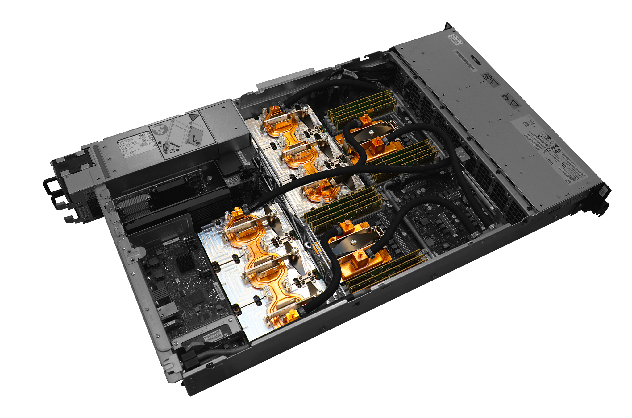
Summit Hardware
Local Network
CPU
CPU
CPU
CPU
CPU
CPU
• • •
GPU
GPU
GPU
GPU
GPU
GPU
GPU
GPU
GPU
GPU
GPU
GPU
GPU
GPU
GPU
GPU
GPU
GPU
Node 1
Node 2
Node 4,608
Each Node
2 IBM 22-core POWER9 processors
6 nVidia Graphics Processing Units
608 GB DRAM
1600 GB Flash
Overall
13MW water cooled
$325 M for two machines

Slide 46
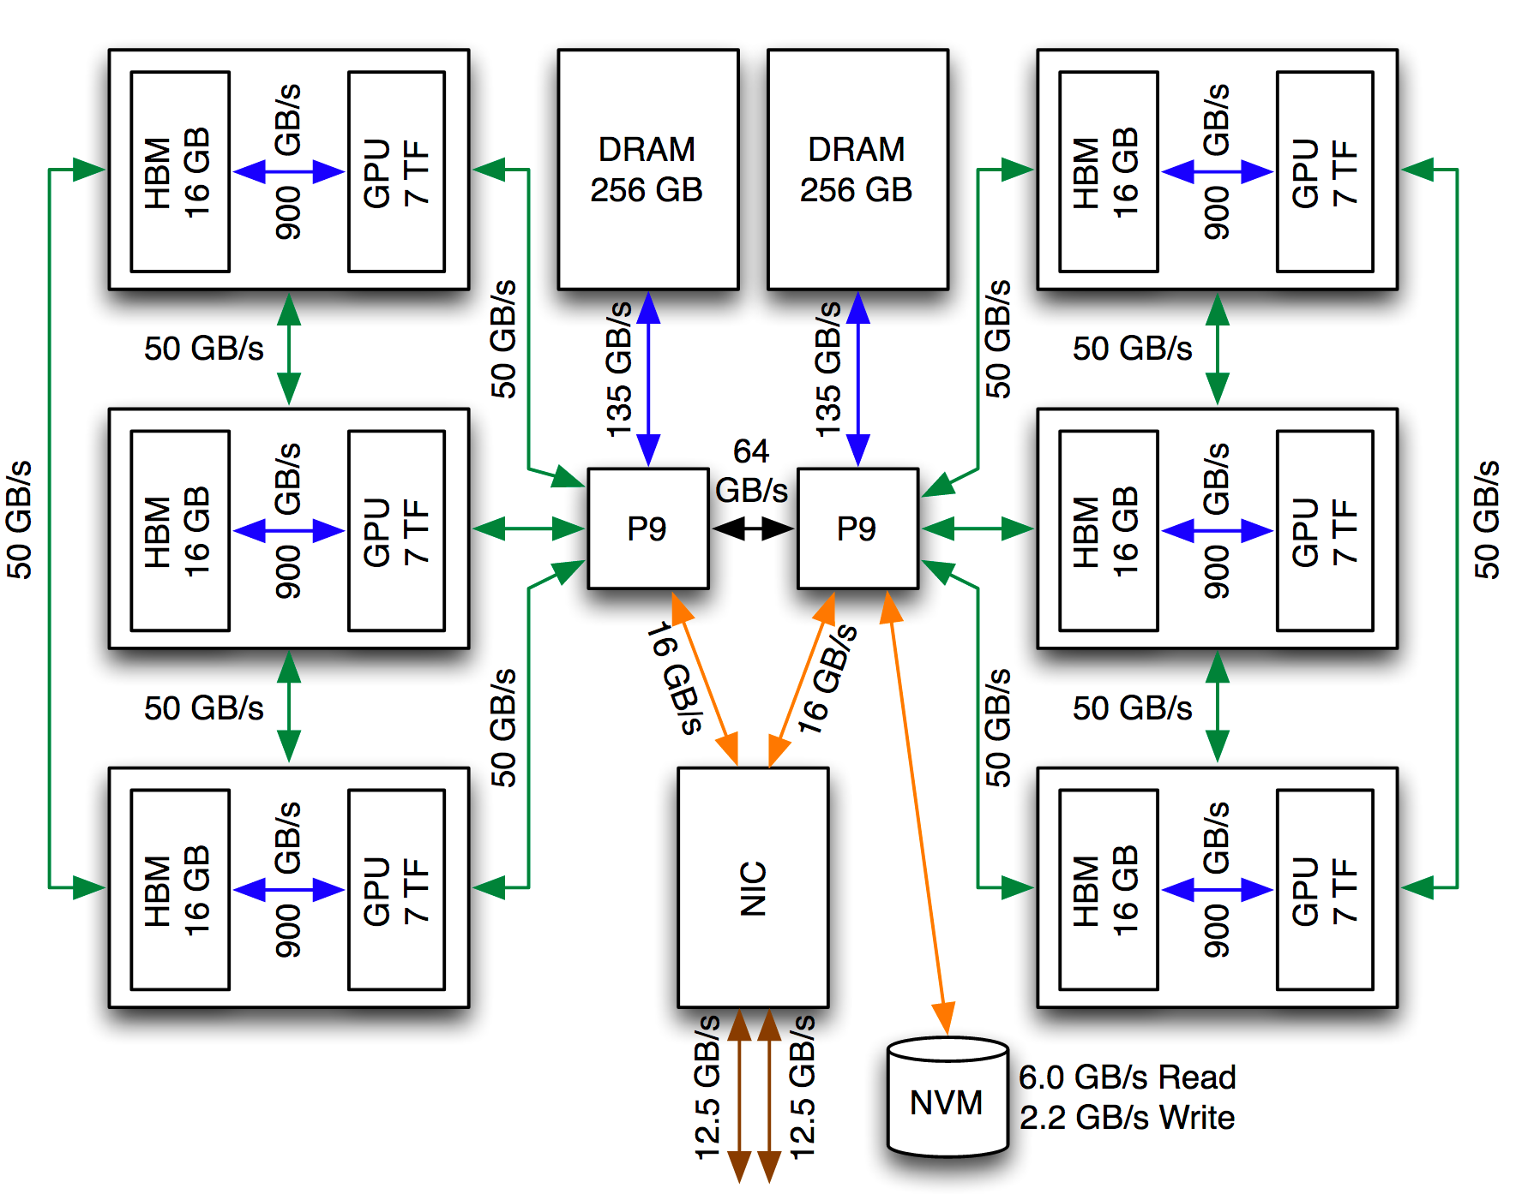
Summit Node Structure

Slide 47
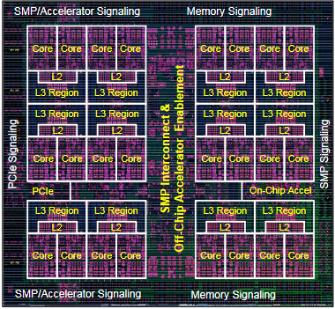
Summit Node Structure: CPU
GPU
GPU
DRAM
Memory
GPU
Interconnection
Network
CPU
22 cores sharing common memory
Supports multithreaded programming
Connects to three GPUs
Connects to interconnection network

Slide 48
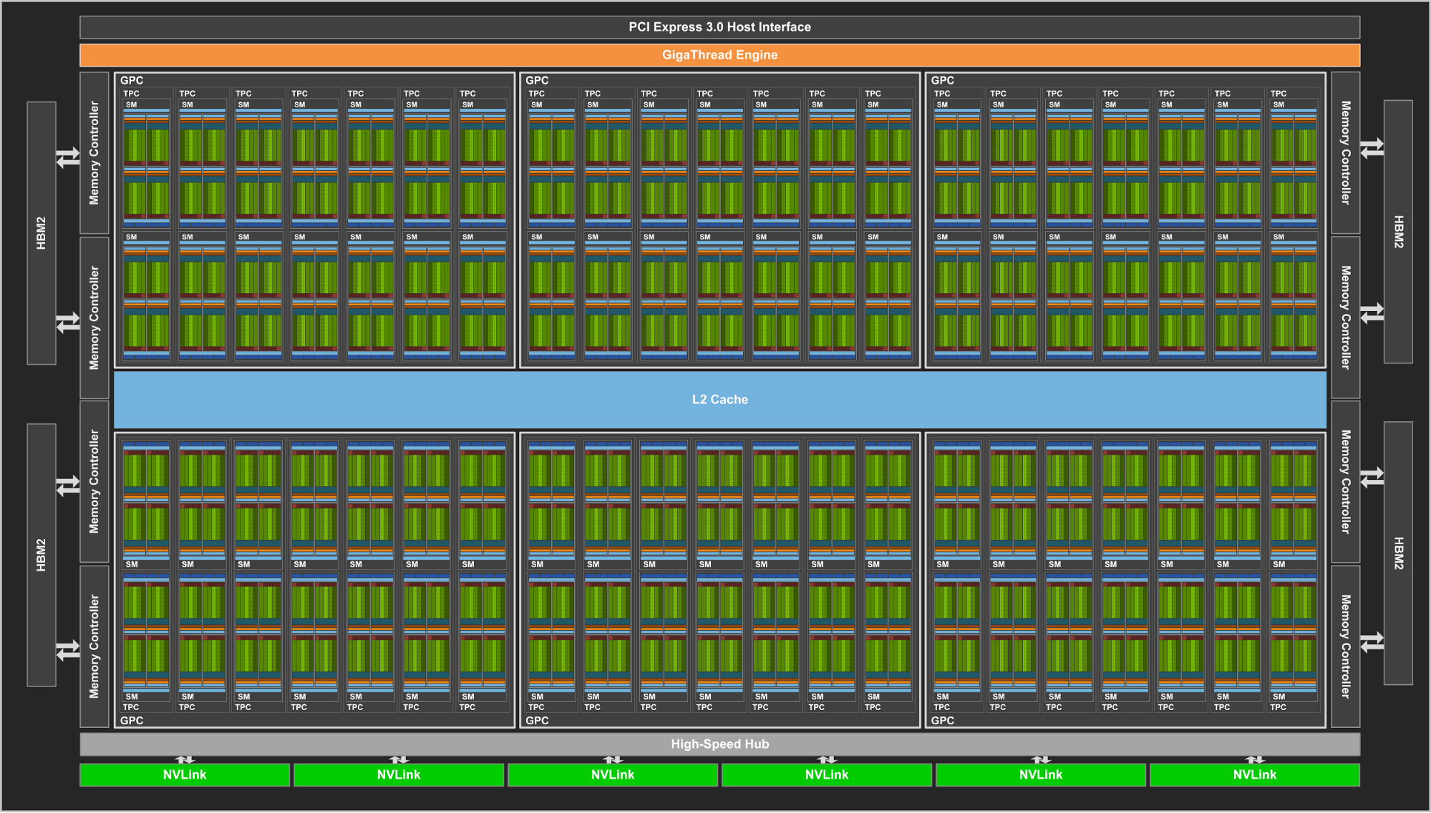
Summit Node Structure: GPU
Tesla V100 GPU
80 streaming multiprocessors (SMs)
Each with multiple execution units: 64 double-precision, 32 single-precision, 32 integer
Single-Instruction, Multiple-Data parallelism
Single instruction controls all processors in group
7 x 10¹² FLOPS peak performance

Slide 49
Supercomputer Programming: Principle
Solving Problem Over Grid
E.g., finite-element system
Simulate operation over time
Bulk Synchronous Model
Partition into Regions
p regions for p-node machine
Map Region per Processor

Slide 50
Supercomputer Programming: (cont)
Bulk Synchronous Model
Map Region per Processor
Alternate
All nodes compute behavior of region
Perform on GPUs
All nodes communicate values at boundaries
P₁
P₂
P₃
P₄
P₅
Compute
Communicate
Compute
Communicate
Compute
Communicate

Slide 51
Bulk Synchronous Performance
P₁
P₂
P₃
P₄
P₅
Limited by performance of slowest processor
Strive to keep perfectly balanced
Engineer hardware to be highly reliable
Tune software to make as regular as possible
Eliminate “noise”
Operating system events
Extraneous network activity
Compute
Communicate
Compute
Communicate
Compute
Communicate

Slide 52
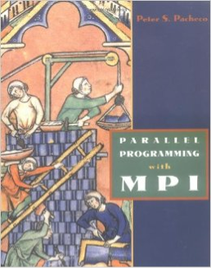
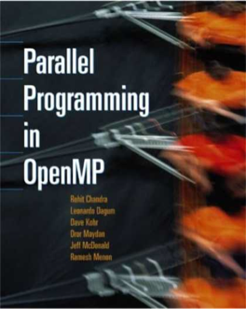
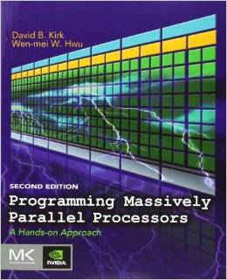
Summit Programming: Reality
System Level
Message-Passing Interface (MPI) supports node computation, synchronization and communication
Node Level
OpenMP supports thread-level operation of node CPU
CUDA programming environment for GPUs
Performance degrades quickly if don’t have perfect balance among memories and processors
Result
Single program is complex combination of multiple programming paradigms
Tend to optimize for specific hardware configuration

Slide 53
My GPU Experience
Multiply two 1024 x 1024 matrices (MM)
2 X 10⁹ floating point operations
Express performance in Giga FLOPS
Program in CUDA and map onto nVidia GPU

Slide 54
Matrix Multiplication Progress
Versions
Naive 1
Simple parallel 11
Blocking 70
nVidia Example Code 388
Reorient memory accesses 382
Packed data access 777
Observations
Progress is very nonlinear
Not even monotonic
Requires increased understanding of how program maps onto hardware
Becomes more specialized to specific hardware configuration

Slide 55
Supercomputer Programming Model
Application
Programs
Program on top of bare hardware
Performance
Low-level programming to maximize node performance
Keep everything globally synchronized and balanced
Reliability
Single failure causes major delay
Engineer hardware to minimize failures
Software
Packages
Machine-Dependent
Programming Model
Hardware

Slide 56
Data-Intensive Computing Landscape
Google Data Center
Data Intensity
Web search
Mapping / directions
Language translation
Video streaming
Internet-Scale
Computing
Cloud
Services
Personal
Computing
Computational Intensity

Slide 57

Internet Computing
Web Search
Aggregate text data from across WWW
No definition of correct operation
Do not need real-time updating
Mapping Services
Huge amount of (relatively) static data
Each customer requires individualized computation
Online Documents
Must be stored reliably
Must support real-time updating
(Relatively) small data volumes

Slide 58


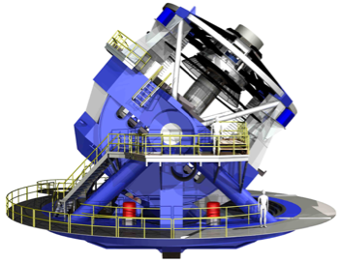
Other Data-Intensive Computing Applications
Wal-Mart
267 million items/day, sold at 6,000 stores
HP built them 4 PB data warehouse
Mine data to manage supply chain, understand market trends, formulate pricing strategies
LSST
Chilean telescope will scan entire sky every 3 days
A 3.2 gigapixel digital camera
Generate 30 TB/day of image data

Slide 59
Data-Intensive Application Characteristics
Diverse Classes of Data
Structured & unstructured
High & low integrity requirements
Diverse Computing Needs
Localized & global processing
Numerical & non-numerical
Real-time & batch processing

Slide 60
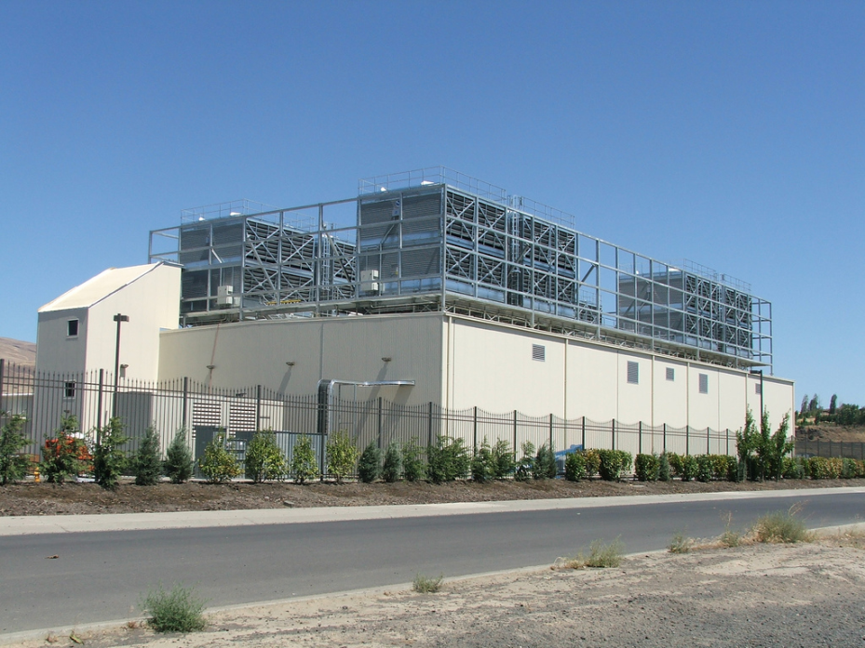
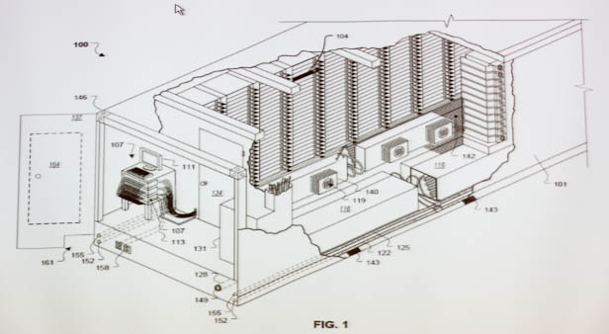
Google Data Centers
Dalles, Oregon
Hydroelectric power @ 2¢ / KW Hr
50 Megawatts
Enough to power 60,000 homes
Engineered for low cost, modularity & power efficiency
Container: 1160 server nodes, 250KW
Notes:
One of the biggest users of cluster computing is Google. They have set up dozens of data centers around the world, containing more computer power than just about anyone else.
Here’s a picture of their data center in Dalles, Oregon. It cost them $600M and requires around 50 megawatts of power. (For reference, that much power would supply the residential electricity needs of 6,000 households in the U.S.). They located the data center near the Columbia River to take advantage of low-cost electricity.
Imagine what our intelligence sources could do if they had facilities on this scale to store and process satellite imagery, voice signals, and feeds from media outlets.

Slide 61
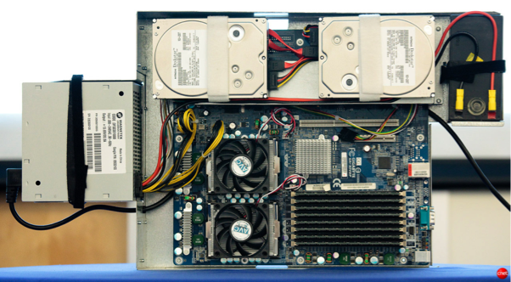
Google Cluster
Local Network
CPU
CPU
CPU
• • •
Node 1
Node 2
Node n
Typically 1,000−2,000 nodes
Node Contains
2 multicore CPUs
2 disk drives (or Flash)
DRAM

Slide 62

Hadoop Project
File system with files distributed across nodes
Store multiple (typically 3 copies of each file)
If one node fails, data still available
Logically, any node has access to any file
May need to fetch across network
Map / Reduce programming environment
Software manages execution of tasks on nodes
Local Network
CPU
CPU
CPU
• • •
Node 1
Node 2
Node n

Slide 63
Map/Reduce Programming Model
k₁
k₁
k_{r}
• • •
Reduce
Key-Value
Pairs
M
M
M
• • •
M
Map
x₁
x₂
x₃
x_{n}
Map computation across many objects
E.g., 10¹⁰ Internet web pages
Aggregate results in many different ways
System deals with issues of resource allocation & reliability
Dean & Ghemawat: “MapReduce: Simplified Data Processing on Large Clusters”, OSDI 2004

Slide 64
Cluster Programming Model
Application programs written in terms of high-level operations on data
Runtime system controls scheduling, load balancing, …
Scaling Challenges
Centralized scheduler forms bottleneck
Copying to/from disk very costly
Hard to limit data movement
Significant performance factor
Application
Programs
Machine-Independent
Programming Model
Runtime
System
Hardware

Slide 65

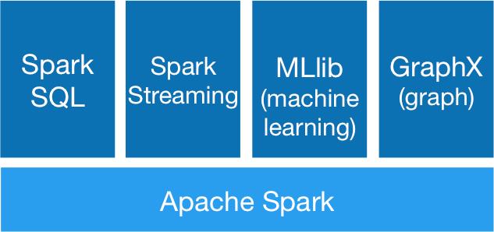


Recent Programming Systems
Spark Project
at U.C., Berkeley
Grown to have large open source community
GraphLab
Started as project at CMU by Carlos Guestrin
Environment for describing machine-learning algorithms
Sparse matrix structure described by graph
Computation based on updating of node values

Slide 66
Computing Landscape Trends
Data Intensity
Oakridge
Summit
Mixing simulation
with data analysis
Modeling &
Simulation-Driven
Science &
Engineering
Traditional
Supercomputing
Computational Intensity

Slide 67

Combining Simulation with Real Data
Limitations
Simulation alone: Hard to know if model is correct
Data alone: Hard to understand causality & “what if”
Combination
Check and adjust model during simulation

Slide 68

Real-Time Analytics
Millenium XXL Simulation (2010)
3 X 10⁹ particles
Simulation run of 9.3 days on 12,228 cores
700TB total data generated
Save at only 4 time points
70 TB
Large-scale simulations generate large data sets
What If?
Could perform data analysis while simulation is running
Simulation
Engine
Analytic
Engine

Slide 69
Computing Landscape Trends
Google Data Center
Data Intensity
Sophisticated
data analysis
Internet-Scale
Computing
Computational Intensity

Slide 70


Example Analytic Applications
Microsoft Project Adam
Classifier
Image
Description
English
Text
Transducer
German
Text

Slide 71

Data Analysis with Deep Neural Networks
Task:
Compute classification of set of input signals
Training
Use many training samples of form input / desired output
Compute weights that minimize classification error
Operation
Propagate signals from input to output

Slide 72


DNN Application Example
Facebook DeepFace Architecture

Slide 73
Training DNNs
Model Size
Training Data
Training Effort
×
➔
Characteristics
Iterative numerical algorithm
Regular data organization
Project Adam Training
2B connections
15M images
62 machines
10 days

Slide 74
Trends
Google Data Center
Data Intensity
Sophisticated
data analysis
Internet-Scale
Computing
Convergence?
Mixing simulation
with real-world data
Modeling &
Simulation-Driven
Science &
Engineering
Traditional
Supercomputing
Computational Intensity

Slide 75
Challenges for Convergence
Supercomputers
Data Center Clusters
Hardware
Customized
Optimized for reliability
Source of “noise”
Static scheduling
Low-level, processor-centric model
Consumer grade
Optimized for low cost
Provides reliability
Dynamic allocation
High level, data-centric model
Run-Time System
Application Programming

Slide 76
Summary: Computation/Data Convergence
Two Important Classes of Large-Scale Computing
Computationally intensive supercomputing
Data intensive processing
Internet companies + many other applications
Followed Different Evolutionary Paths
Supercomputers: Get maximum performance from available hardware
Data center clusters: Maximize cost/performance over variety of data-centric tasks
Yielded different approaches to hardware, runtime systems, and application programming
A Convergence Would Have Important Benefits
Computational and data-intensive applications
But, not clear how to do it

Slide 77
Overall Summary
Consumer products and supercomputers share technology
CMOS integrated circuits
Flash memory
Both are power limited
Heat / cooling
Battery life or utilities
Until recently, technology followed predictable trends
But, these are harder to sustain
Both technology and cost

